Slide 1
Introduction to image Analysis
Segmentation 2
Robert Haase, Benoit Lombardot
MPI-CBG, Scientific Computing Facility
October 23rd - 25th 2017
Section goals :
Combine Images
Filter structure by size and measure distance
Segment tightly connected object
Record your pipeline in Macros

Slide 2
Overview
Image Analysis, Segmentation 2
Day 1:
Introduction & basic concepts
Segmentation 1
Day 2:
Measure in time sequence and tracking
Segmentation 2
Day 3:
Visualize and Explore 3D images
Spot detection and segmentation in 3D

Slide 3

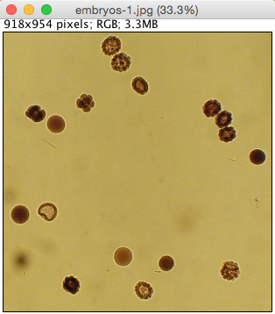
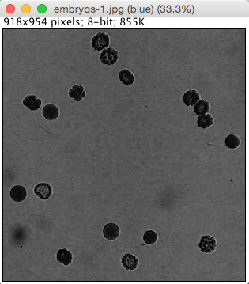
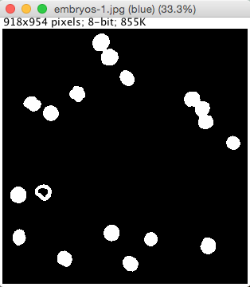
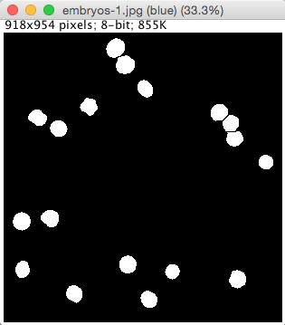
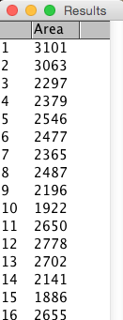
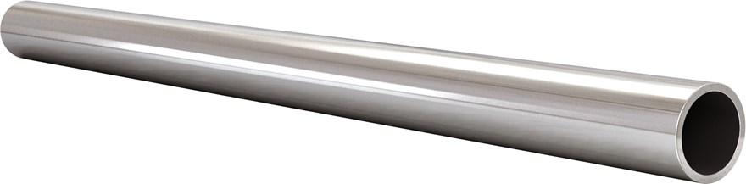
Image Analysis, Segmentation 2 Analysis pipelines
Preprocessing
Segmentation
Postprocessing
Measure

Slide 4
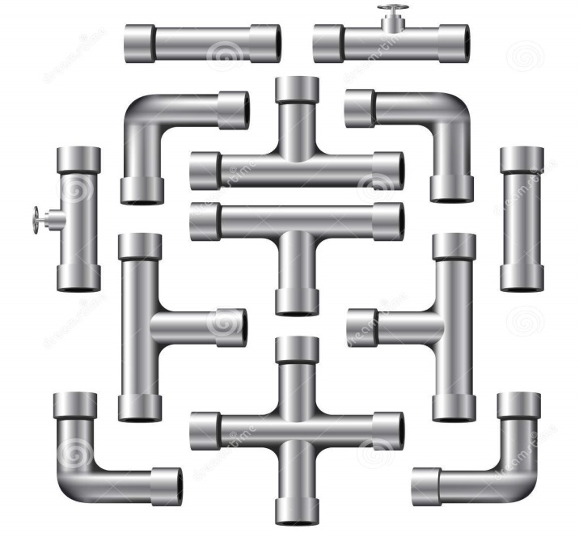
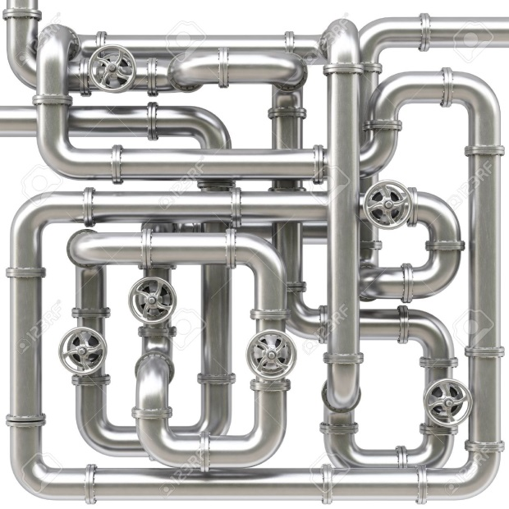
Image Analysis, Segmentation 2 Motivations
Combination of basic operations
Session goals
New operations
Learn to repeat pipeline

Slide 5
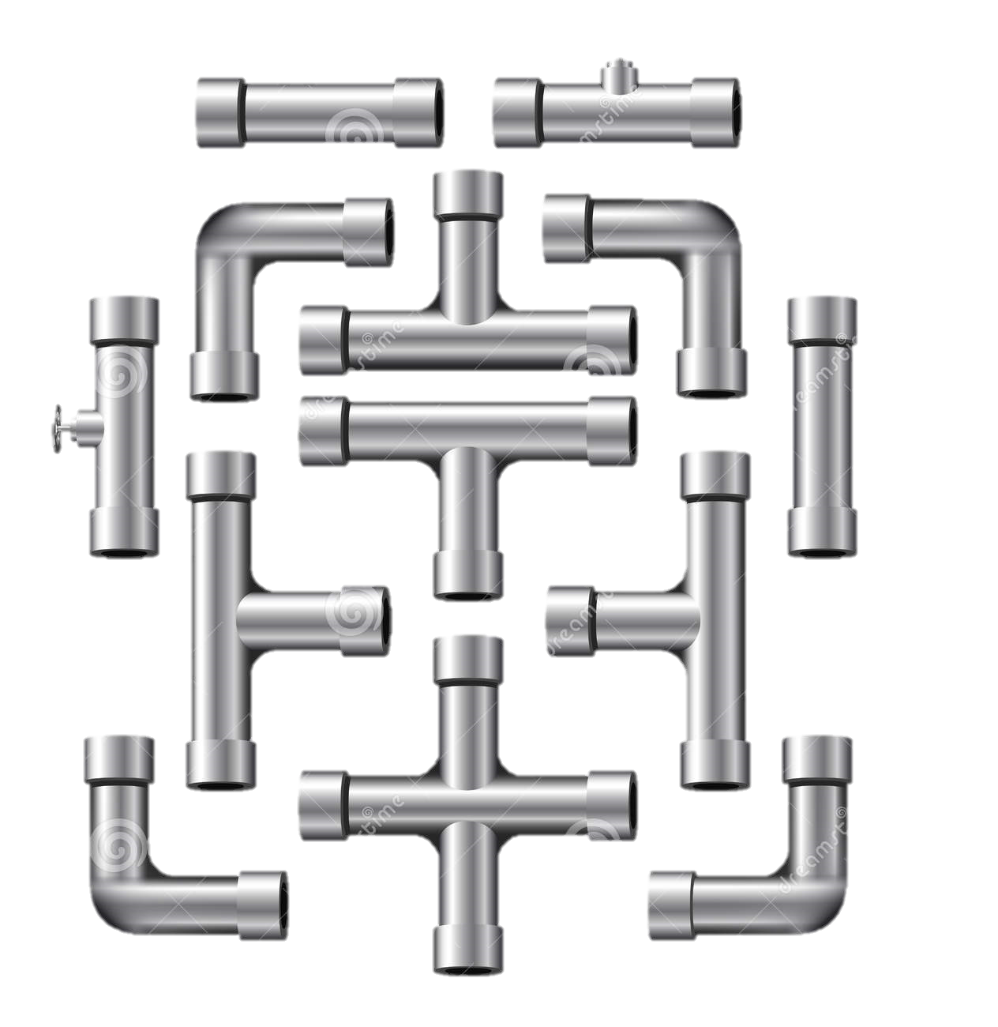
Image math

Slide 6
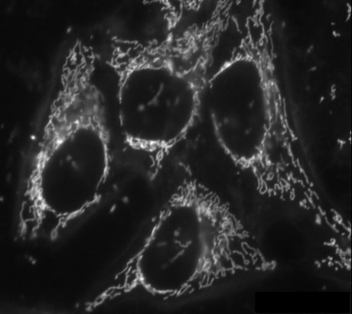
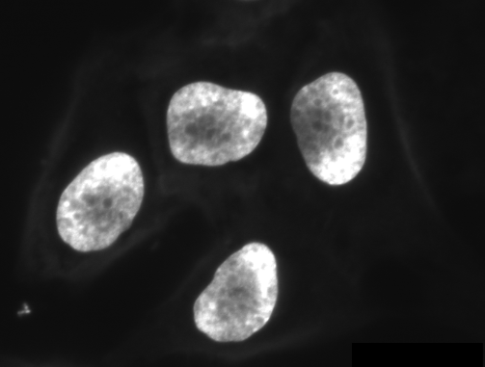
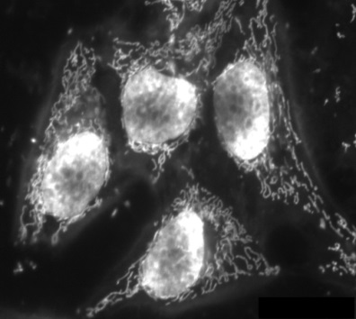


Image analysis, Segmentation 2 Images operations
Image of same size can also be combine with operations +, -, x, /, >, <, =
316
402
718
Notes:
Remark an exercise can be to calculate the mean and standard deviation in a mask with image operation
The only measure than can be used is the mean
Mean of the image pixel intensities, std dev of the image (stdDev = sqrt( <I^2>-<I>^2 ) where <.> is the mean)
Mean in a Mask.
Measure mask area
Measure average intensity in the mask
Measure stdDev in the mask
How to modify the calculus if there is a camera offset in the image

Slide 7

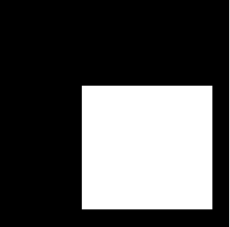



Image analysis, Segmentation 2 Images operations
Particularly useful to combine masks
And
Or
Notes:
Can write logical operations if necessary on the screen

Slide 8
Size and distance

Slide 9

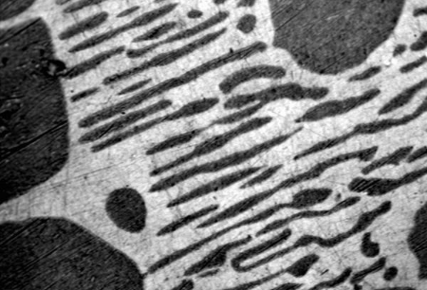
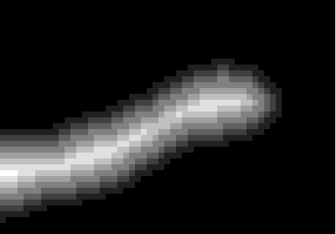
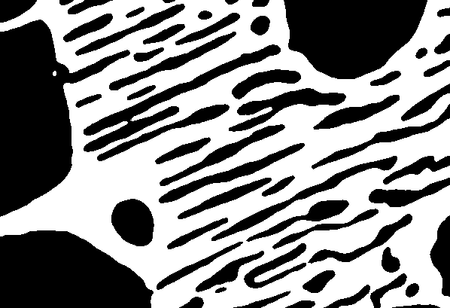
Distance map
Image analysis, Segmentation 2
Input: Mask
Output: gray level image
Pixel intensity = pixel distance to the mask border

Slide 10
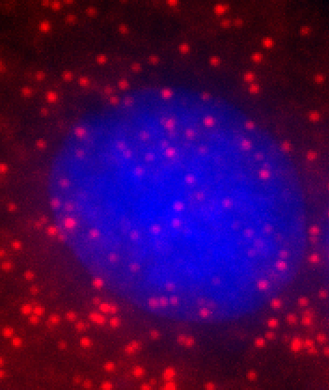
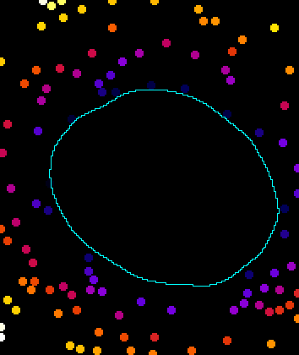

Distance map
Image analysis, Segmentation 2
Application:
measure distance between object
Number of objects within range d
Spots distance visualization
80
0

Slide 11
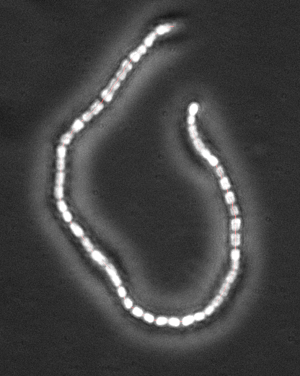

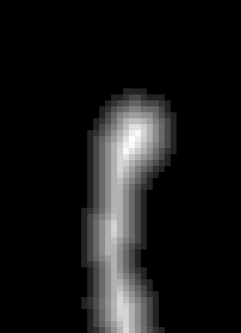

Image Analysis, Segmentation 2 Skeletonization
Mask
Distance map
Crest line or
minimum slope line

Slide 12
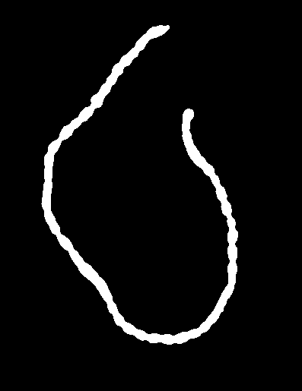
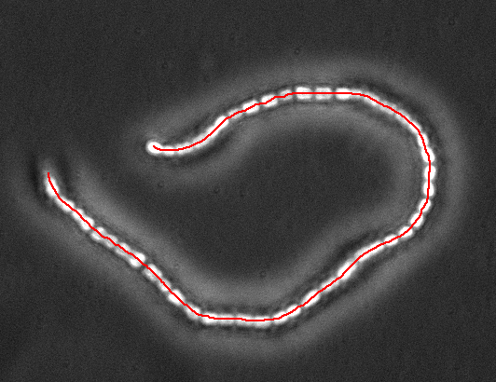
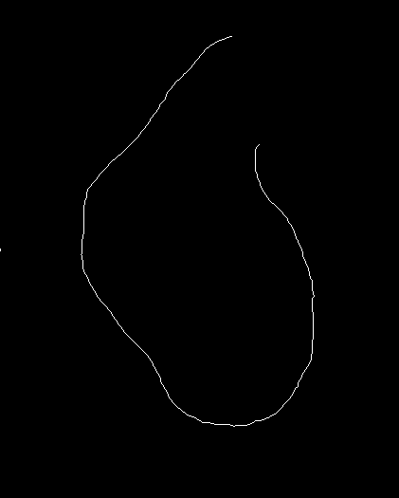
Image Analysis, Segmentation 2 Line detection
Create a mask
Skeletonize
Analyze skeleton
& overlay

Slide 13
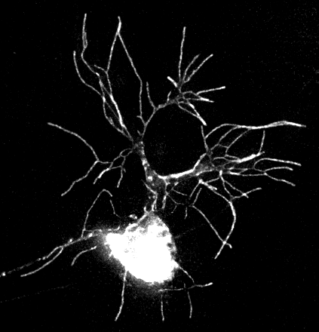
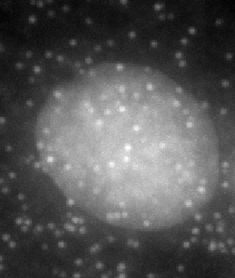
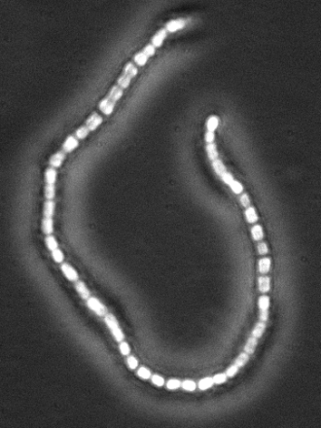
Image analysis, Segmentation 2 Mathematical morphology (MM)
Small and large objects can appear in a single channel
Mathematical morphology is providing tools to analyze them separately
(1) Neuron, Xin Liang (Howard Lab MPI-CBG),
(2) Chain of cells, http://forum.imagej.net/t/counting-cell-chain-length/1794,
(3) Nuclei and transcripts, Carine Stapel (vastenhouw lab, MPI-CBG)
(4) AuPbSn40, available from ImageJ menu File>Open samples

Slide 14
Image analysis, Segmentation 2 MM, mask filters
Dilation by a disc
Erosion by a disc

Slide 15
Image analysis, Segmentation 2 MM, mask filters
Closing : Fill the gaps thinner than the disc
Closing: Dilation then Erosion → Fill thin gaps in shapes
Opening: Erosion then dilation → Erase thin bands in shapes

Slide 16
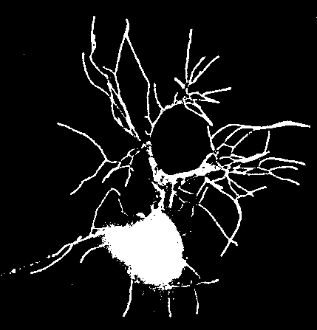
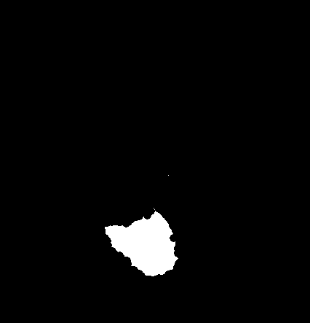
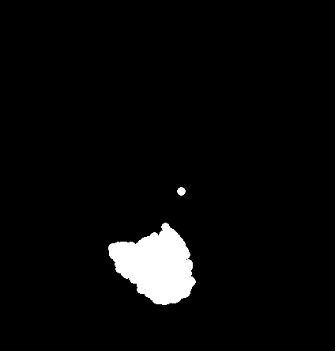
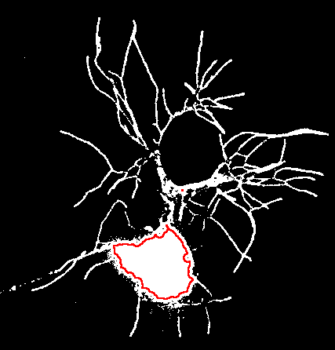
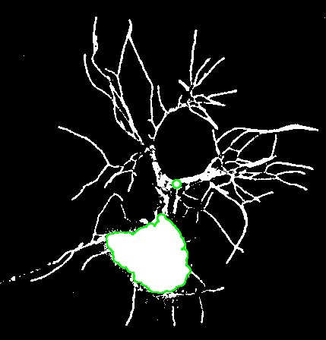
MM, mask filtering
Image analysis, Segmentation 2
Opening
Erosion
Dilation
Opening erase small objects while preserving the shape

Slide 17
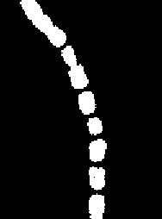
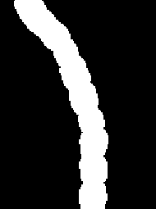
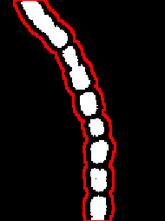
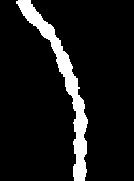
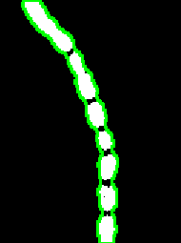
MM, mask filtering
Image analysis, Segmentation 2
Closing
Dilation
Erosion
Closing fill small gaps while preserving the shape

Slide 18
Watershed

Slide 19
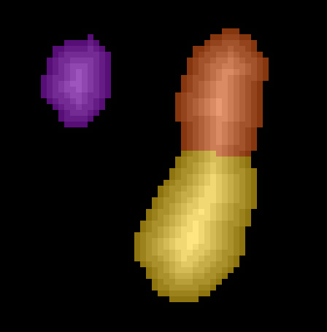
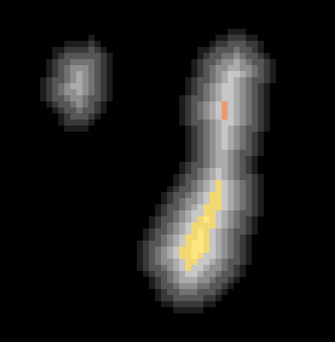
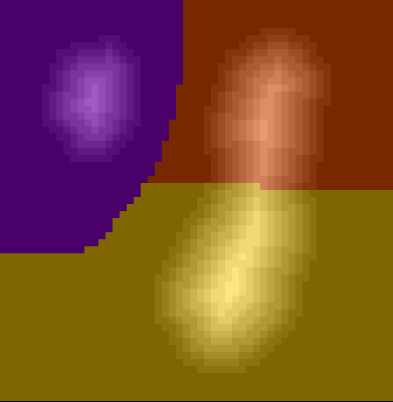
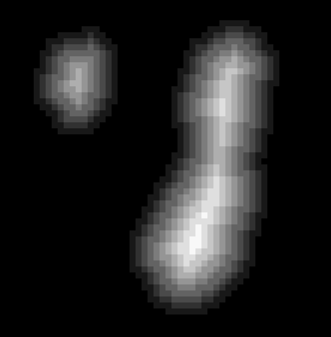
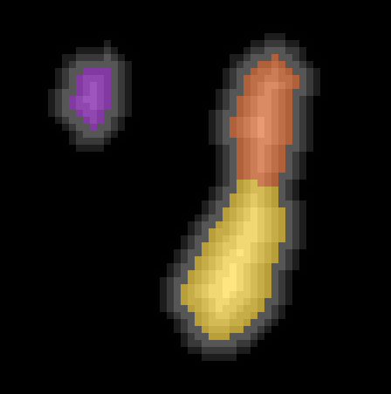
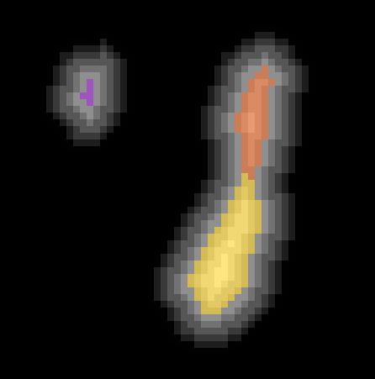
Watershed
Image analysis, Segmentation 2
A 1D explanation along the red cut
Watershed algorithm
gradually flood an image peaks from its maxima until it reaches a threshold (the stopping criteria).
White
Black
Notes:
Many variant, but we stick with the flooding from maxima today

Slide 20
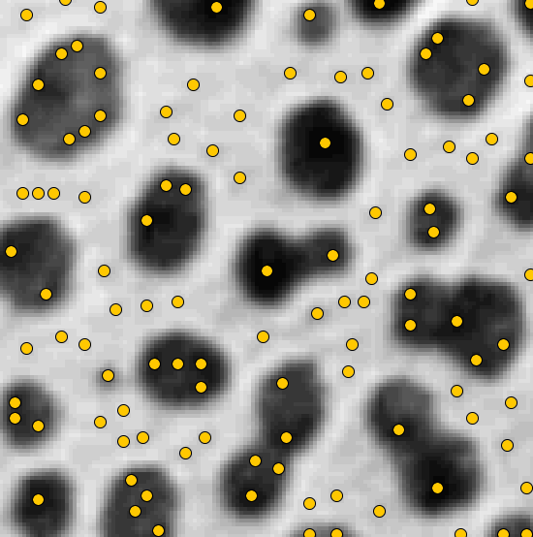
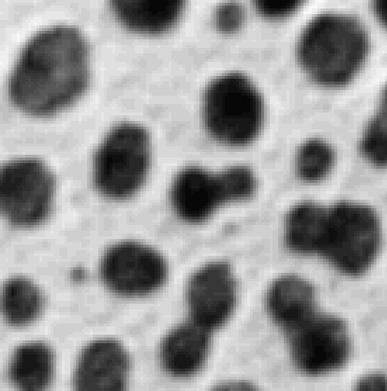
H-Maxima
Image analysis, Segmentation 2
Can one detect Object With Maxima?
→Maxima are sensitive to noise
Notes:
Watershed works if maxima match with object we search

Slide 21
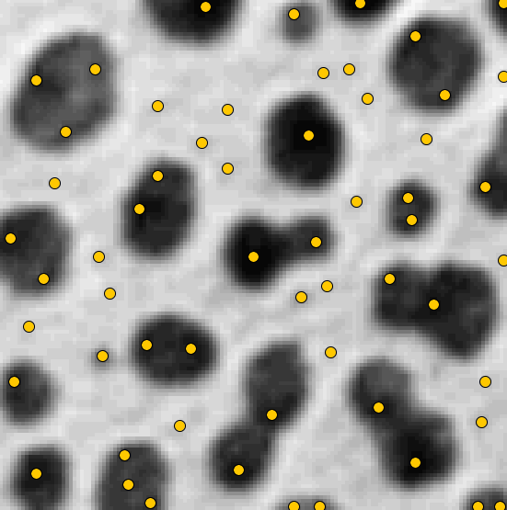
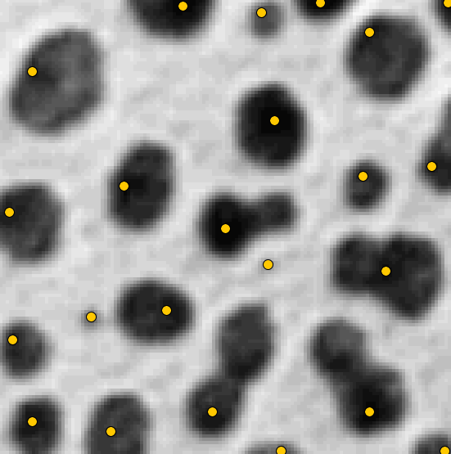
H-Maxima
Image analysis, Segmentation 2
Can one detect Object With Maxima?
→Maxima are sensitive to noise
Some maxima are more robust to noise
→ Select maxima by their dynamics
H-Maxima, H=10
H-Maxima, H=0
H-Maxima, H=40
Notes:
Watershed works if maxima match with object we search

Slide 22

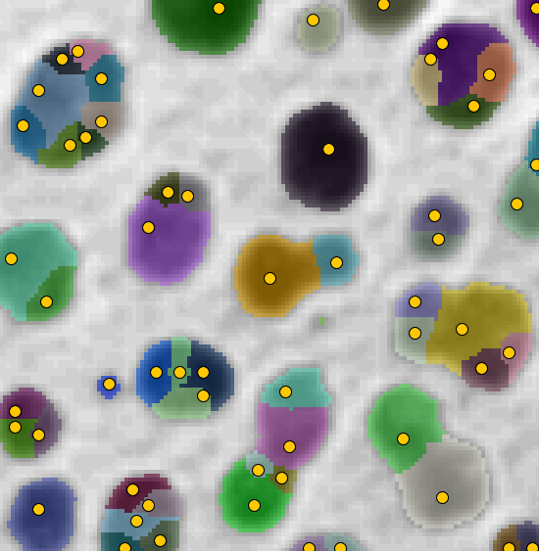
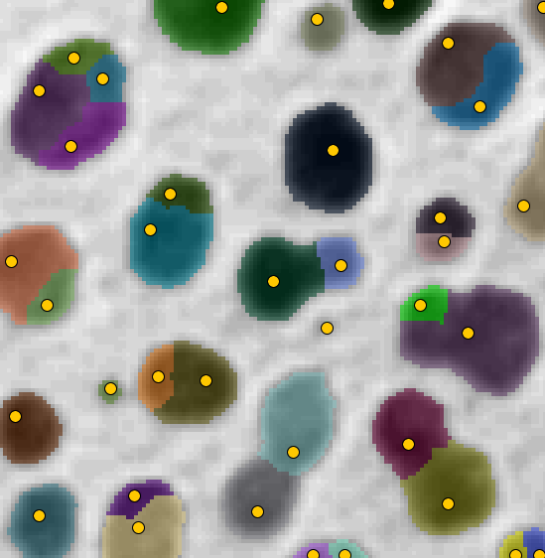
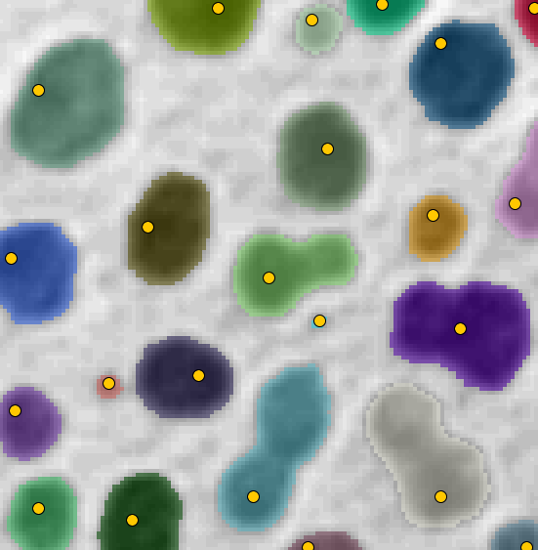
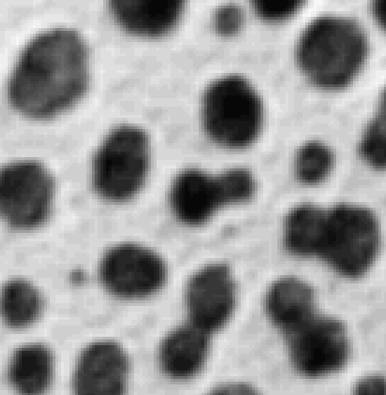



H-Watershed
Image analysis, Segmentation 2
A simple, robust strategy to segment objects
H-Watershed parameter space
H value
T=0, H=0
T=100, H=0
T=100, H=10
T=100, H=40
T value
Notes:
Watershed works if maxima match with object we search

Slide 23
Macro Recording

Slide 24


The Macro Recorder
Image analysis, Segmentation 2
➔ Menu Plugins>Macro>Record…
Notes:
The Macro recorder
Set your language
Demo!

Slide 25







The Macro Recorder
Image analysis, Segmentation 2
Notes:
Analysis of the blobs image:
Some command lines appears in the recorder every time we do an action in the user interface
From the text:
Many run(…) (but not only)
And all that sounds quite related to what we did
We’ll go in the details but before that let go to the usefulness of it

Slide 26



The Macro Recorder
Image analysis, Segmentation 2
Notes:
To run your macro:
Click “create” to open your recording in the script editor
Open a new image and run the macro
It works right away!
Each command processes the image in focus
In practice the image in focus is often the one that was created or modified by the previous command
Or the last one clicked before you run the macro

Slide 27




The Macro Recorder
Image analysis, Segmentation 2
➔ run( “Menu Entry”, “some parameters”)
Notes:
Step by step analysis of the blobs image:
Some command lines appears in the recorder every time we do an action in the user interface
Duplicate
Gaussian blur
Threshold
Uncheck “dark background”
Apply threshold
ParticleAnalyzer ( show count mask, summarize, exclude on edge)
Set LUT to “glasbey”
Most of the time: run( “Menu Entry”, “some parameters”)
Only when we manipulate the threshold things sounds more complicated
Each command process the current window
It modifies the current window (or creates a new one and sets it at the current window)

Slide 28

Hands on!
Notes:
Demo:
- open : soma size (neuron_60x.tif : open+thresh)
- skeletonisation: cell chain ( + close )
Watershed : show on blobs then on droso (Drosophila_2D_Race.tif ), proper count (show a difficult case)
- Distance : transcript distance to nuclei
- Nuclei+transcript toy :

Slide 29
Hands on!
Notes:
Demo:
mask combination
Mask opening
Mask closing
Separating small and large object
Distance map
Skeletonization
Interactive watershed
Macro recording
Width and length of cells chain : thresh, closing, skeletonize, analyze skeleton, distance map, multiply
Mette 2D seg: interactive watershed, blur, interactive watershed, close, interactive watershed
Nucleus + transcript image
Particle distribution in nucleus: closing, distance, particle analyzer
Proportion of the spot within 10 um of the nucleus border: thresh, erode, subtract, max finder, and, particle analyzer
Image to determine: Signal intensity as a function of the distance to cell membrane
Neuron: size of the soma, number of process starting in the soma
Vesicle fusion:
number and size in time: subtract bg, thresh, particle analyzer in time, summary
position in time: distance map, maxima detector, multiply, particle analyzer + summary
Easy fly wing: interactive watershed, particle analyzer
Hard fly wing: closing, thresh, erode, interactive watershed, multiply

Slide 30


MM, mask filtering
Image analysis, Segmentation 2
Original
Opening
Neurites mask

Slide 31
Image Analysis, Segmentation 2 Line detection
Create a mask
Skeletonize
Analyze skeleton
& overlay

Slide 32





Watershed on gray level images
Image analysis, Segmentation 2
Use it when background cannot be thresholded

Slide 33



Distance map
Image analysis, Segmentation 2
Measures distance from one object and many others
To measures spot distance to the nucleus:
With set measurements, redirect measures to the nuclei distance map
Then measure spot intensity with the particle analyzer.
Nucleus mask
80
Spots detection
Spots distance visualization
Distance to nuclei
0

Slide 34

Demo
Image analysis, Segmentation 2
Fiji pointers
Image Operation
Process>Math>…
Process>Image Calculator
Erosion, dilation
Process>Filter>Minimum
Process>Filter>Maximum
Distance map
→ Process>Binary> Distance Map
Demo: nuclei_transcripts_zebrafish_zoom_1ch.tif
Separate nuclei and transcripts
Create a mask for nuclei and a mask for transcripts
Count transcript in the nuclei
Measure the density of transcript.
Alternatively Semi manual analysis
Measure density in a crown of 5 micrometer

Slide 35


MM, graylevel filtering
Image analysis, Segmentation 2
Opening
Erosion
Dilation

Slide 36

MM, graylevel filtering
Image analysis, Segmentation 2
Original
Opening
Transcripts image
This is the algorithm used to subtract background!

Slide 37



Image analysis, Segmentation 2 Images operations
In practice: selecting spots in a nuclei region
In Fiji use the plugin:
Process>ImageCalculator

Slide 38




MM, mask filtering
Image analysis, Segmentation 2
Dilation
Original
Mask
Band / Contour
With erosion one could also create band inside the object

Slide 39




Image analysis, Segmentation 2 Images operations
In practice: Increase the contrast between two image
Image source: Jaydeep Sidhaye (Norden lab, MPI-CBG)

Slide 40






Distance map
Image analysis, Segmentation 2
Measures the width of an elongated object
Mask
To estimate width:
With set measurements, redirect measures to the distance map
Then Measure the skeleton average intensity.
Distance map
Skeleton
Distance on the object skeleton
6
0

Slide 41

MM, graylevel filtering
Image analysis, Segmentation 2
Pixel distance to the closest point in the mask
Closing

Slide 42






Watershed on gray level images
Image analysis, Segmentation 2
Use it when background cannot be thresholded
Maxima detection
Segmented cells
Overlaid contours
Measures

Slide 43
Exercises

Slide 44

Exercise 1
Image analysis, Segmentation 2
Rods average length
Estimate rods average length Remark : not all objects are needed for the average Remark: use skeletonize
Make a macro to handle the task
rods.tif

Slide 45

Exercise 2
Image analysis, Segmentation 2
Vesicle fusion
Find a strategy to count vesicles outside the nuclei
Turn the strategy in a macro
Cell_vesicles_t11.tif

Slide 46
Exercise
Image analysis, Segmentation 2
Vesicle fusion: Make 2 macros
Vesicle Number and size in time:
Remove Nuclei
Subtract Background
Vesicle size
Thresh, Particle Analyzer + Summary
Number of vesicle within 10 um of the nuclei in time:
Create a band of 10 um around the nuclei
Thresh, Dilate, Subtract
Count maxima in the band
Maxima detector, And, PA with summary

